Slide 1
Python week 9
Canberra Chinese School Sem2

Slide 2

Mini game 1
Dice Game
A die is rolled. You can keep rolling it to add to your score, but you lose everything if you roll a 1.

Slide 3
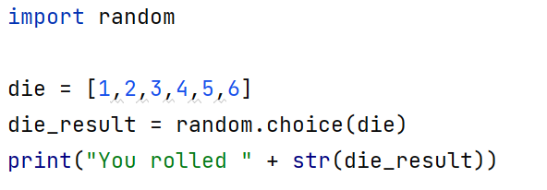
Mini game 1
We can start off by defining the die.

Slide 4
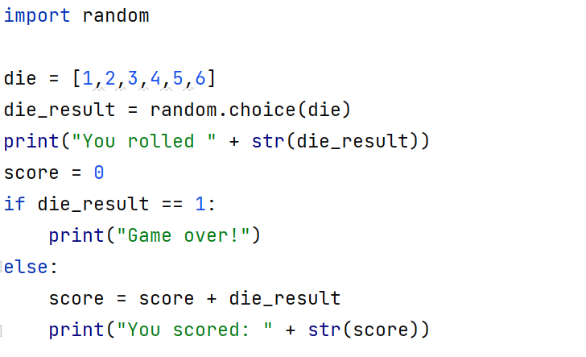
Mini game 1
Let’s write down the logics.

Slide 5
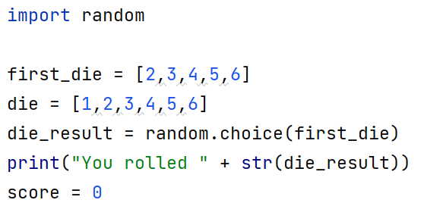
Mini game 1
Perhaps it’s a bit more friendly for the player if we can’t roll a 1 on the first roll.

Slide 6
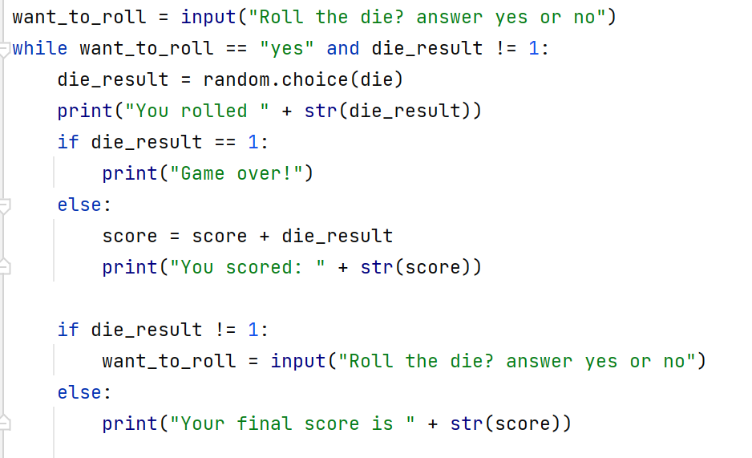
Mini game 1
Then we can keep the game going with this

Slide 7
Mini game 2
Higher or lower
The computer generates a random number between 1 and 100. Your job is to guess if the next number it generates is larger or smaller than the previous one. You have 3 strikes before you’re out. Keeps track of score.

Slide 8
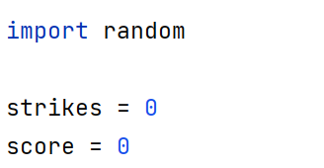
Mini game 2
Let’s define some variables

Slide 9
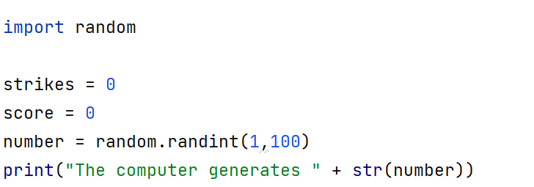
Mini game 2
This generates the first number

Slide 10
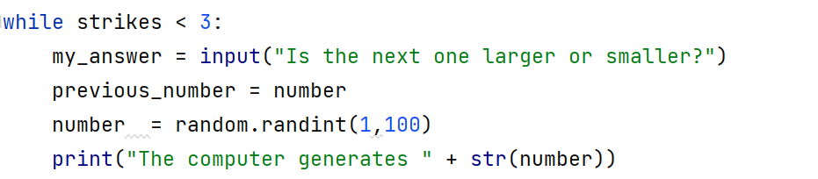
Mini game 2
We want to keep generating the number, as long as strikes is less than 3. We also want to store the previous number, so that we can compare it with the current one.

Slide 11
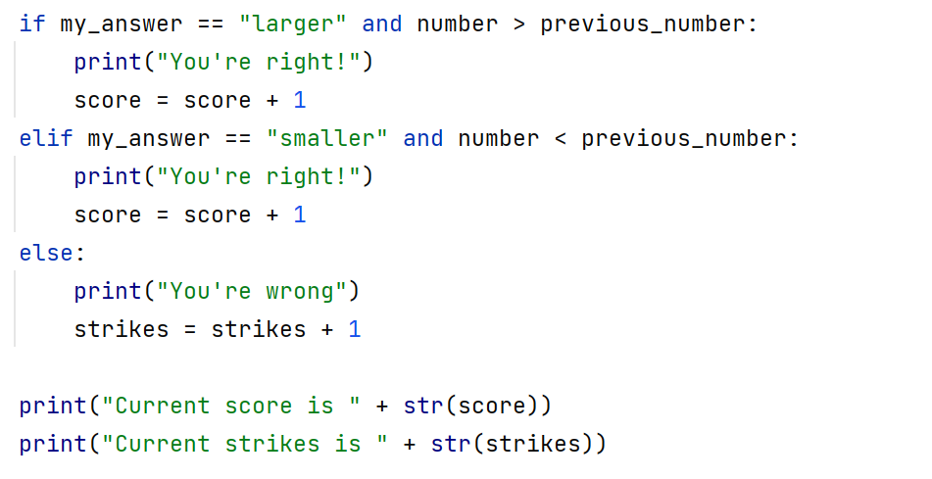
Mini game 2
We can compare them like this

Slide 12
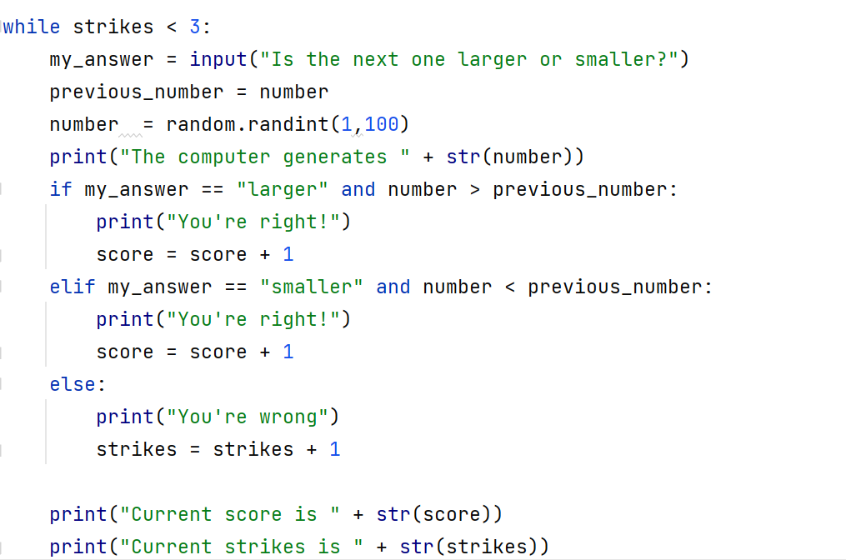
Mini game 2
Final logic

Slide 13
Mini game 2
The python files for mini game 1 and 2 are uploaded on the repository. The homework for the holiday is to make mini game 3 on your own.

Slide 14
Mini game 3
Rock Paper Scissors
The computer plays rock paper scissors with you. The program simulates one turn of rock paper scissors, and prints if the player wins or loses after the player makes their move.

